Slide 1
Compile and Run
Compile: g++ lab1_file_transfer.cpp –o lab1_file_transfer
Run: ./lab1_file_transfer <protocol> <character> <ip> <port> <file>
<protocol>: tcp or udp
<character>: send or recv
<ip>: ex: 127.0.0.2
<port>: for communication (need to be the same, ex: 9453)
<file>: file name, only sender need to provide this
Run sender first

Slide 2
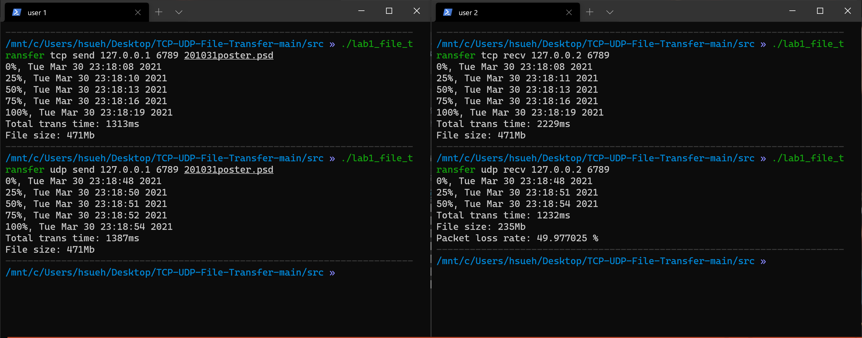
F74071027 作業截圖

